Slide 2
Mission and Vision
Mission
Communities with diverse religious beliefs live in peace and harmony in Myanmar.
Vision
Advance inter-communal harmony and social cohesion through interreligious cooperation.

Slide 3
Basic Principle
Respect religious differences
Act on deeply held and widely shared values
Preserve the identity of each religious community
Honor the different ways religious communities are organized
Link local, regional and national religious and multi-religious structures

Slide 4
About us
In June 2012, religious communities in Myanmar came together to form Religions for Peace - Myanmar (RfP-M) as the country first full-fledged representative and action-oriented interreligious body for reconciliation, peace and development. RfP-M brings together all of the four major religions of Myanmar; Buddhism, Christianity, Islam and Hinduism and was officially inaugurated in September 2012.RfP-Myanmar is one of Religions for Peace’s 90 National Affiliates. RfP-M consists of Myanmar historic religious traditions and organizations including the Sitagu International Buddhist Academy; the Ratana Metta Organization (Buddhist); the Myanmar Council of Churches (MCC); the Catholic Church; the Sanatan Hindu Organization in Myanmar; and the Islamic Centre of Myanmar. RfP-M works at the national, regional and local levels and capitalizes on each organization ability to mobilize its existing infrastructure of thousands of local congregations. It offers a platform for religious leaders on joint advocacy, coordinated program response and training, mobilization of local communities around issues of public concern and for channeling resources through local congregations and other faith groups.

Slide 5
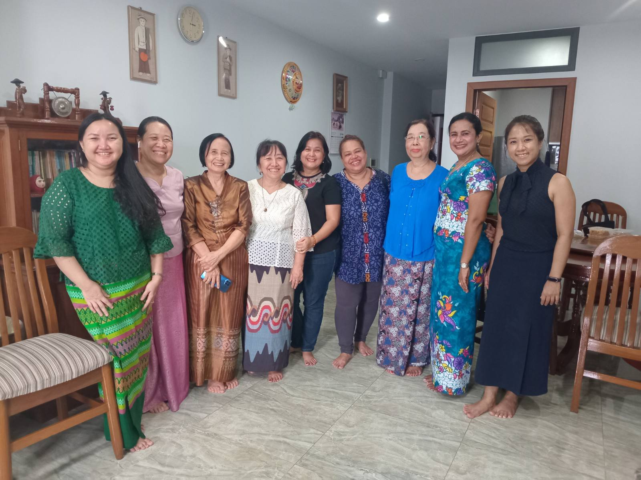
Wofn gathering

Slide 6
Conflict Transformation Workshop 25.9.2024

Slide 7
16 Day Activism 25.11.2024

Slide 8
8.3.2025 IWD day, Hmawbi, Catholic Sister House

Slide 9
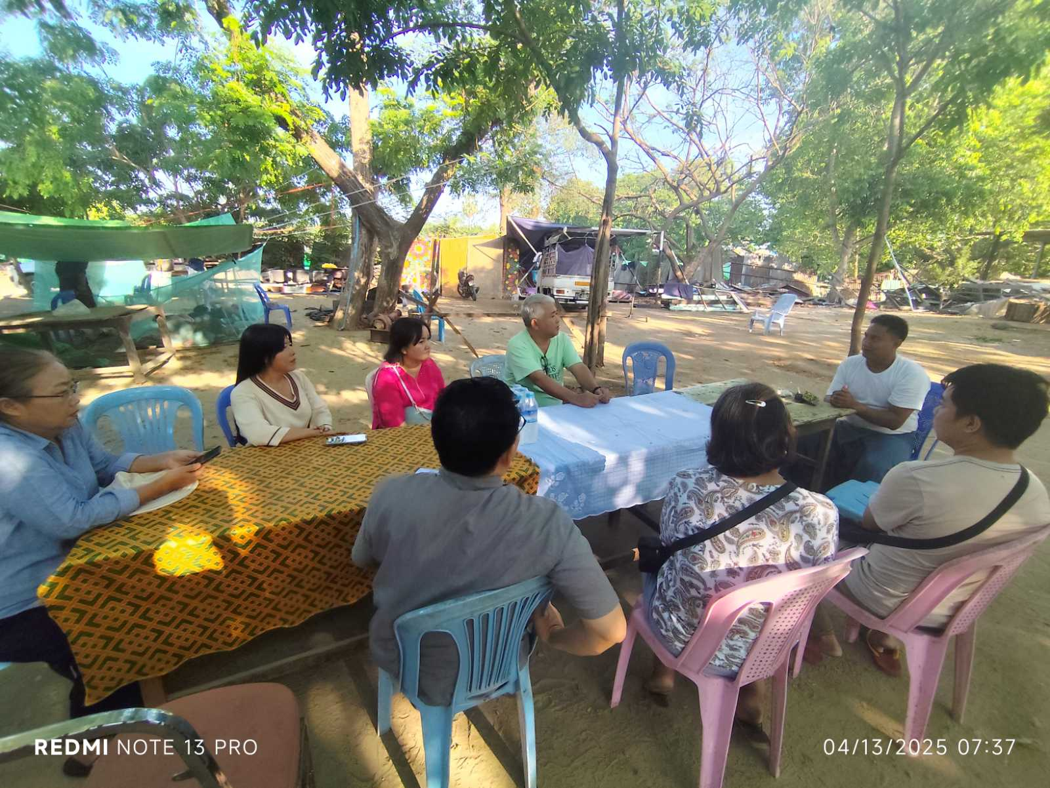
Earthquake(Mandalay)
Earthquake Response donation
Earthquake Response visit

Slide 10
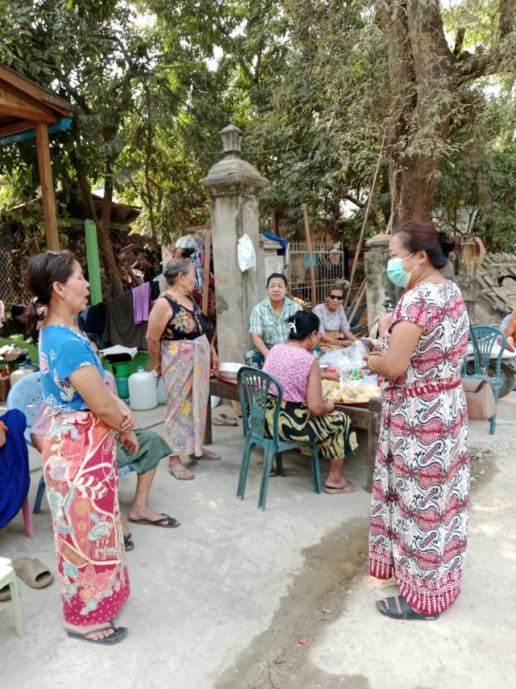
Earthquake response
Rapid Need Assessment in Sagaing
Rapid Need Assessment in Sagaing

Slide 11
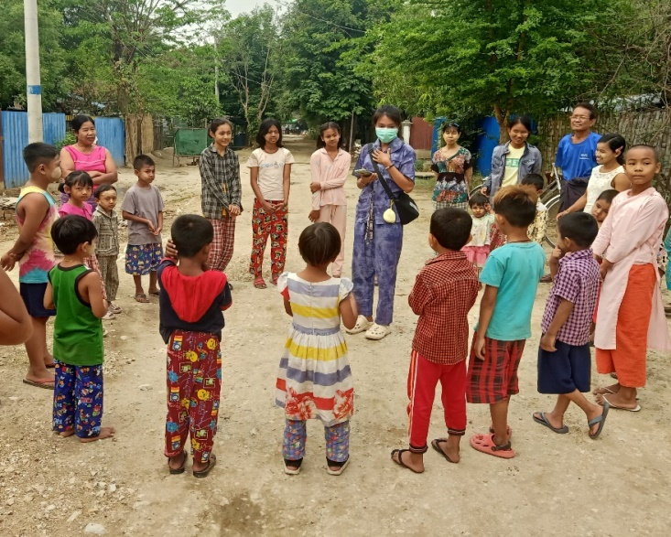
Earthquake response
PSS activity with Children in Sagaing
PSS activity with Children in Sagaing

Slide 12
UNICEF Project Period November 2024 to July 2025
Project Name: Support Holistic Child Protection and Mitigate the risks of children in conflict areas through Faith Network and Community-based Child Protection Mechanism

Slide 13
Project Areas
Kayah State – Demoso (East), Demoso(West), Hpruso,
Southern Shan State –Taunggyi, Nyaung Shwe, Aye Tharyar, Pekon
Sagaing region – Shwe Bo, Mon Ywar
Magway region – Hsin Phyu Kyun, Sa Lin.

Slide 14
Project Activities
Advocacy Meeting
Child Protection Group Monthly Meeting
Child Protection Awareness Raising
Psychosocial Support Sessions
Child Protection Case Management

Slide 15
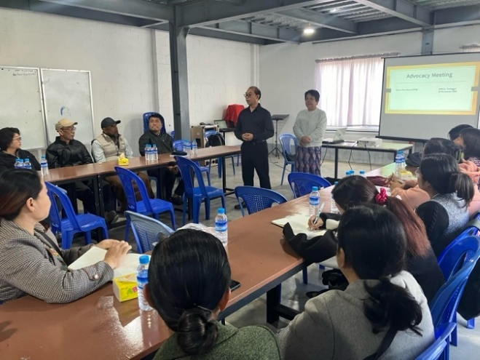
1.advocacy Meeting
Kyaukdaing Ywarthit Monastery
Advocacy Meeting with Faith leaders, UNICEF Field Officrs and IDPs at the YMCA hall, Taunggyi, Southern Shan State.

Slide 16
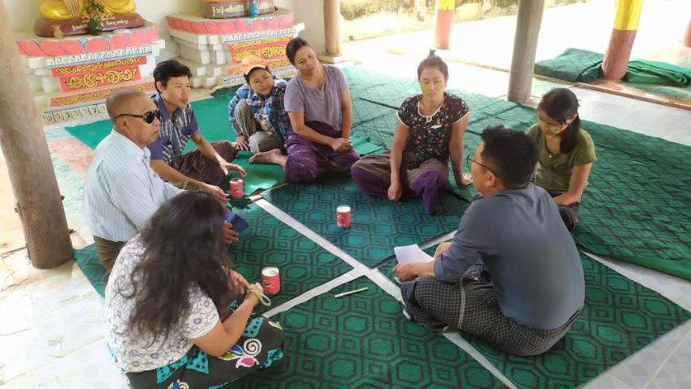
2.Cpg meeting
CPG monthly meeting conducting in a target village of Magway region
CPG monthly meeting conducting in an IDP camp of Hpruso township, Kayah state

Slide 17
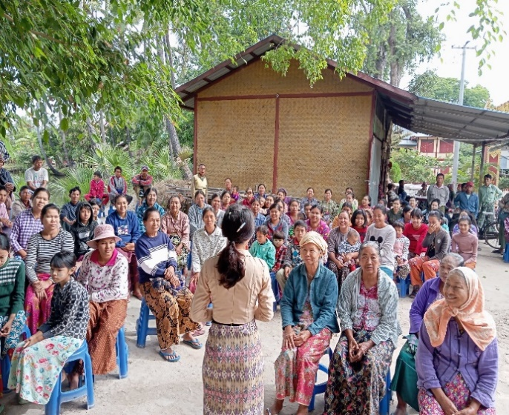
3.Child Protection Awareness Raising
CPCR awareness raising session for children being conducted in a camp of Demoso West, Kayah state
CPCR awareness raising session for Parents or caregiver being conducted

Slide 18
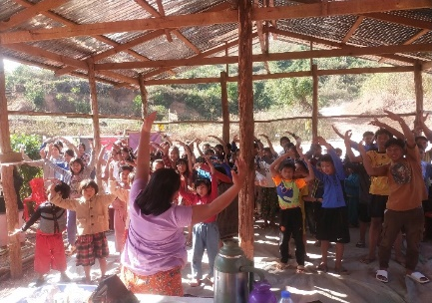
4. Psychosocial Support Sessions
PSS activity for parents and caregivers
PSS activity for Children

Slide 19
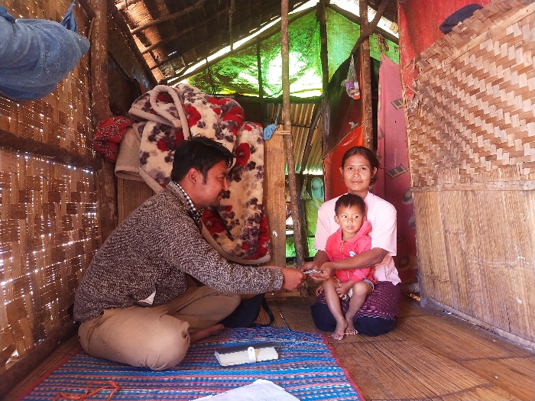
5.Child Protection Case Management
Providing victim support assistance to Child Protection case

Slide 20
Achievement Child Protection Group Forming
Sr | State/Region | Township | Group | Male | Female | Total
1 | Kayah | Deemawso (east) | 3 | 6 | 10 | 16
2 |  | Deemawso (west) | 3 | 2 | 13 | 15
3 |  | Hpruso | 3 | 8 | 7 | 15
4 | Southan Shan | Pekon (west) | 3 | 10 | 11 | 21
5 |  | Taunggyi | 3 | 0 | 23 | 23
6 |  | Nyaung Shwe | 3 | 3 | 12 | 15
7 | Magway | Salin & Sin Phyu Kyun | 6 | 13 | 31 | 44
8 | Sagaing | Shwe Bo & Mon Ywa | 3 | 6 | 11 | 17
Total |  |  | 27 | 48 | 118 | 166

Slide 21
Achievement Child Protection Awareness and PSS
No | Township | Child Protection Awareness |  |  |  |  |  | Psychosocial Support Activities
 |  | Male | Female | Total | Boy | Girl | Total | Male | Female | Total | Boy | Girl | Total
1 | Deemawso (east) | 197 | 597 | 794 | 519 | 527 | 1046 | 100 | 220 | 320 | 196 | 284 | 480
2 | Deemawso (west) | 231 | 674 | 905 | 439 | 440 | 879 | 132 | 468 | 600 | 460 | 454 | 914
3 | Hpruso | 261 | 691 | 952 | 504 | 552 | 1056 | 116 | 407 | 523 | 339 | 464 | 803
4 | Pekon (west) | 253 | 682 | 935 | 573 | 612 | 1185 | 253 | 654 | 907 | 608 | 663 | 1271
5 | Taunggyi | 95 | 429 | 524 | 257 | 329 | 586 | 196 | 678 | 874 | 474 | 579 | 1053
6 | Nyaung Shwe | 182 | 615 | 797 | 296 | 353 | 649 | 141 | 550 | 691 | 977 | 1060 | 2037
7 | Salin & Sin Phyu Kyun | 44 | 449 | 493 | 177 | 189 | 366 | 66 | 948 | 1014 | 546 | 673 | 1219
8 | Shwe Bo & Mon Ywa | 266 | 898 | 1164 | 470 | 478 | 948 | 130 | 786 | 916 | 495 | 502 | 997
Total |  | 1529 | 5035 | 6564 | 3235 | 3480 | 6715 | 1134 | 4711 | 5845 | 4095 | 4679 | 8774
 | Target

Slide 22
Achievement Case Management Support
No | State | Township | Boy | Girl | Total
1 | Kayah | Deemawso (east) | 3 | 5 | 8
2 | Kayah | Deemawso (west) | 5 | 5 | 10
3 | Kayah | Hpruso | 3 | 9 | 12
4 | Shan | Pekon (west) | 7 | 3 | 10
5 | Shan | Taunggyi | 5 | 2 | 7
6 | Shan | Nyaung Shwe | 2 | 5 | 7
7 | Magway | Salin & Sin Phyu Kyun | 6 | 2 | 8
8 | Sagaing | Shwe Bo & Mon Ywa | 2 | 1 | 3
Total |  |  | 33 | 32 | 65

Slide 23
Challenges
Daily maneuvering of fighter jets, airstrikes, artillery shelling and displacement increased.
Fighting increased due to open season without rain, resulted in the increase of IDPs from Moe Bye, SSS side moving into Kayah state side.
Transportation and communication have become more difficult
As displacement period prolonged, needs of IDPs increased in terms of Education, health and livelihood.
Food shortage, lack of job opportunity, increase of commodity prices
Activities are hampered by resume fighting in open season

Slide 24
Challenges
Local Administration instructed the IDP camp committee to return to their original places by the end of February.
Even though the IDPs want to return, they have no more home or , it is not safe to return
Difficulty in IDP camps has increased due to fund collection, population data collection and seizure of people to serve in MAF as set by conscription law.
Check point gates increased and communication cut off time extended.
Staff with documents become stressful when passed by the check points

Slide 25
Challenges
Unusual check points were found frequently on the way to projected villages.
Staff are at risk as the check points used to open up materials and documents, .
For some villages the staff is concern for gathering of people to conduct activities.
It is riskier for the male staff and male volunteer to travel into the field.
Difficult to buy the items required for project implementation
Frequent fighting in the projected area is a challenge to travel

Slide 26
conclusion
Although Nyein Chan Metta (RfP-M) have difficulty and challenges, we try our best to reach more and more to the community. Please support and pray for us.

